Slide 1
MuscleHub A/B Test
Should we ask all customer to finish a fitness test?

Slide 2
A/B Test Process
MuscleHub
Visitors
Group A
Fitness
Test
Submit
Application
Pay Membership
Group B
Step 1: Determine A/B test sample size
Step 2: Investigate the A/B Test Variants
Step 3: Hypothesis Testing
Notes:
Currently, when a visitor to MuscleHub is considering buying a membership, he or she follows the following steps:
Take a fitness test with a personal trainer
Fill out an application for the gym
Send in their payment for their first month's membership
We are interested that whether the fitness test intimidates some prospective members, so we decide to run an A/B test to help us choose the better decision that will increase our conversion rate.
We first decide how many samples do we need to run a A/B test. Here, Sample size for each test group is already given as 2500(Data collected after 07-01-2017), else it should be calculated from Baseline Conversion Rate, Minimum Detectable Effect and Statistical Significance.
And since we are interested in whether fitness test helps us increase customer conversion rate. We randomly assign half of our customers into another group who skip the fitness test and proceed directly to the application.
We did three hypothesis tests between the two groups so that we know whether the differences are statistically significant.

Slide 3
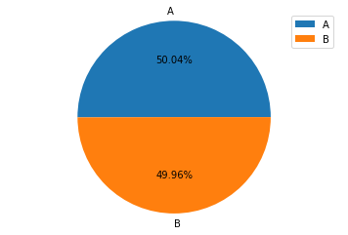
Select Dataset From Database
There are four tables in the database contain useful information for our analysis.
Visits
Fitness_tests
Applications
Purchases
Final Dataset:
A/B Test Period: 07.01.2107 to 09.09.2017
Data Size : 5004 rows(2504 for “Group A” and 2500 for “Group B”)
New Columns : “ab_test_group”, “is_application” and “is_member”.
Notes:
Visits (information about customers who have visited MuscleHub from 05-01-2017 to 09-09-2017)
Fitness_tests (information about customers in "Group A", who were given a fitness test)
Applications (information about any customers who filled out an application)
Purchases (information about customers who purchased a membership)
We first pulled only data collected during our test period from 07-01-2107 to 09-09-2017 from table visits. Then we perform a series of LEFT JOIN on first_name, last_name, email to combine four tables into one dataset. Other columns were added such as ab_test_group(Determined from fitness_test_date) tells us what group does a customer belong to; is_application(Determined from application_date) tells us whether this customer submit a application form and is_member(Determined from purchase_date) tells us whether a customer send their payment to us for their first month’s membership.

Slide 4
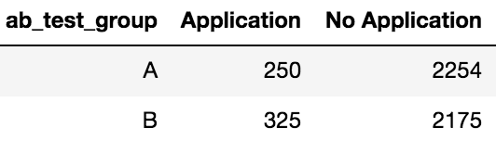
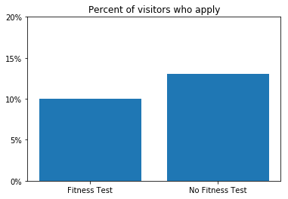
Hypothesis Tests Results
Test 1:Which group are more likely to pick up an application?
Hypothesis Test : Chi Square Test
P-Value: 0.0009
Conclusion: People from Group B are more likely to submit an application.
Notes:
Since the we want to compare whether number of applications from two groups of people are significant(four possible outcomes, and two categories(A/B), we use Chi Square Test.
The result from the test gave us p = 0.0009 < 0.05, we can confidently say that the difference is statistically significant.

Slide 5
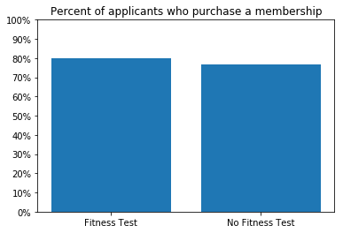
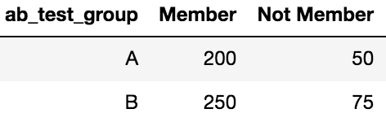
Hypothesis Tests Results
Test 1:For people who already submit applications, which group are more likely to purchase a membership.
Hypothesis Test : Chi Square Test
P-Value : 0.43
Conclusion: After submitting applications, people from both group show no difference towards purchasing an membership.
Notes:
It looks like people who took the fitness test were more likely to purchase a membership if they picked up an application. However, is the difference statistically significant?
The result from the test gave us p = 0.43 > 0.05, we can not reject the null hypothesis, thus after submitting applications, chance of people from both group purchasing a membership are equal.

Slide 6
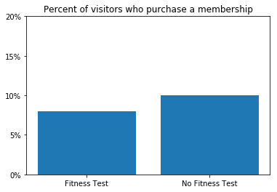
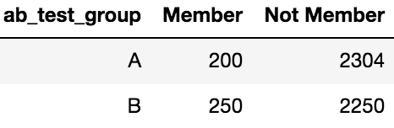
Hypothesis Tests Results
Test 1:Which group are more likely to purchase a membership?
Hypothesis Test : Chi Square Test
P-Value : 0.01
Conclusion: People from Group B are more likely to purchase an membership.
Notes:
Previously, when we only considered people who had already picked up an application, we saw that there was no significant difference in membership between Group A and Group B.
Now, when we consider all people who visit MuscleHub.
since p = 0.01 < 0.05, we see that there might be a significant difference in memberships between Group A and Group B.

Slide 7
Customer Interview Insights
Helpful for newbies
Equipment maintenance and cleanliness
Shorten the sign-up process
Trainer’s proper interactions
Notes:
Fitness test can be helpful for some newbies, but people could also be intimidated by the intensity of the test.
Equipment maintenance and cleanliness also affect people’s decision.
Shorten the Sign-up process is important for visitors.
Trainer’s proper interactions with visitors can motivate their interest as well. Do not try too hard to sell the membership.

Slide 8
Recommendation
Shorten the sign up process and make fitness test an hidden option for visitors instead of a standard process.
Notes:
From the A/B Test result, people who skip fitness test are more likely to eventually purchase a membership to MuscleHub. Shorten the sign up process and make Fitness Test an hidden option for visitors instead of a standard process. We want our customer to have a pleasure sign-up experience. Save their time and increase our conversion rate.

